Slide 1

WQD7007 Big Data Management
Introduction to big data

Slide 2
Agenda
What is big data?
Characteristic of big data
Big data and small data
Four phases of big data
When big data is needed?
Key obstacles of the big data applications
Application

Slide 3
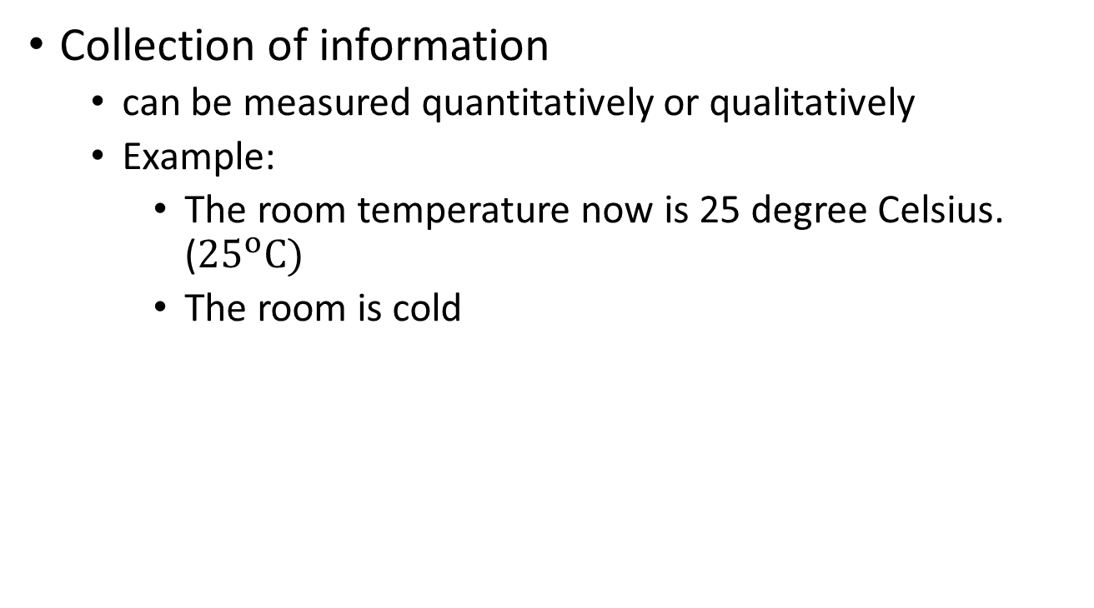
What is data?
What is big data?
WQD7007 Big Data Management
Collection of information
can be measured quantitatively or qualitatively
Example:
The room temperature now is 25 degree Celsius. (${25}^{o}C)$
The room is cold
Notes:
Quantitative: measureable in value
qualitative: description

Slide 4
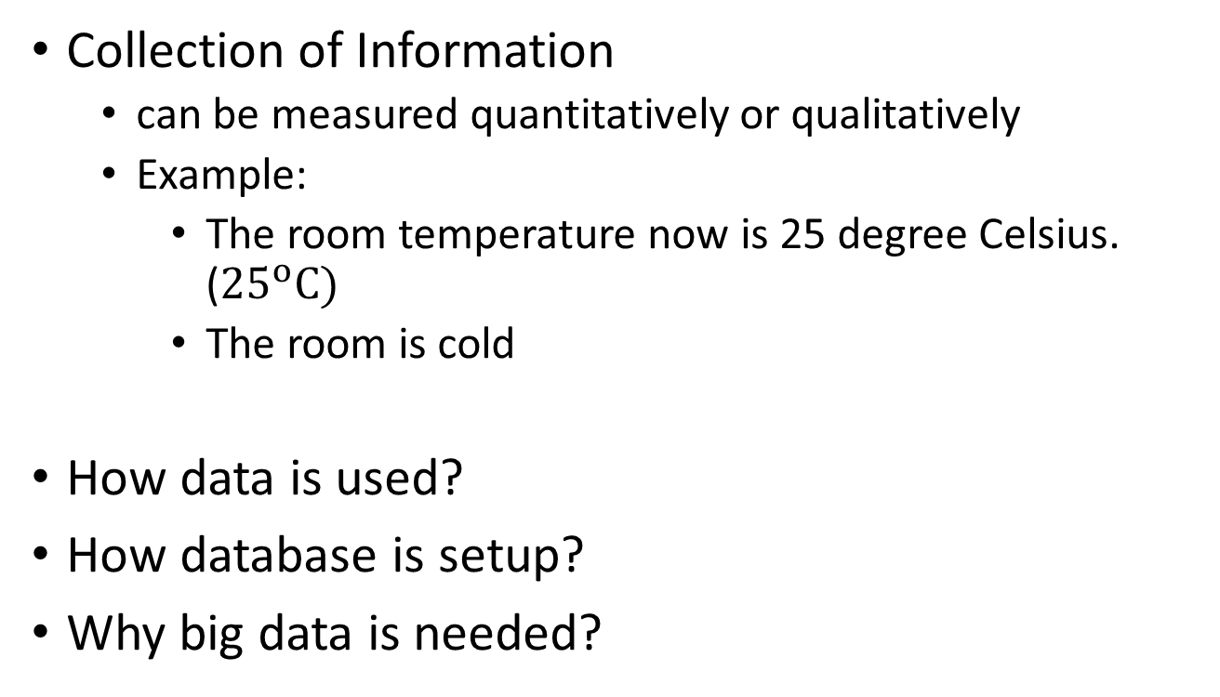
What is Data?
What is big data?
WQD7007 Big Data Management
Collection of Information
can be measured quantitatively or qualitatively
Example:
The room temperature now is 25 degree Celsius. (${25}^{o}C)$
The room is cold
How data is used?
How database is setup?
Why big data is needed?
Notes:
Quantitative: measureable in value
qualitative: description

Slide 5
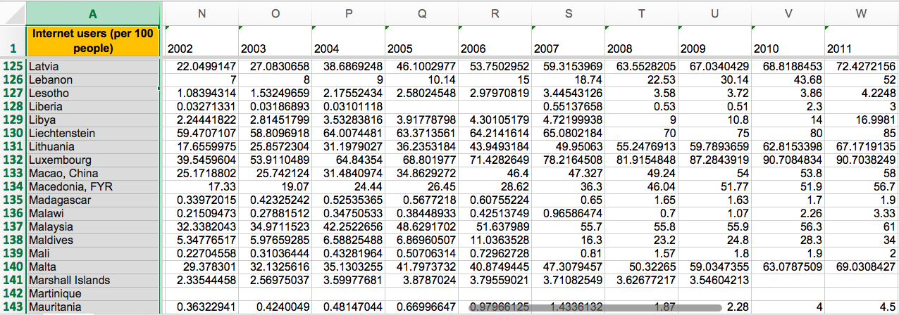
Example: Internet users per 100 people
WQD7007 Big Data Management

Slide 6
Characteristics of big data
WQD7007 Big Data Management
(Source: http://www.ibmbigdatahub.com/infographic/four-vs-big-data)

Slide 7
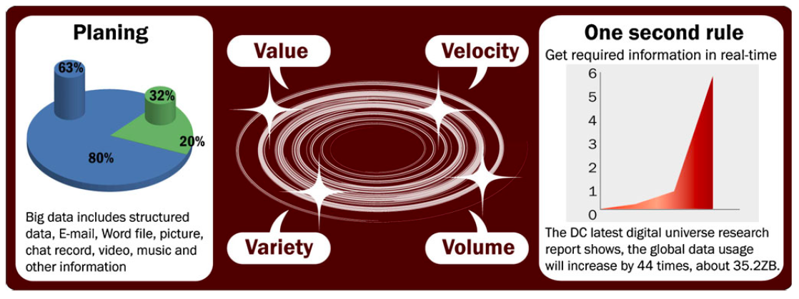
Characteristics of Big Data
WQD7007 Big Data Management
[1] M. Chen, S. Mao and Y. Liu, "Big Data: A Survey", Mobile Networks and Applications, vol. 19, no. 2, pp. 171-209, 2014.

Slide 8
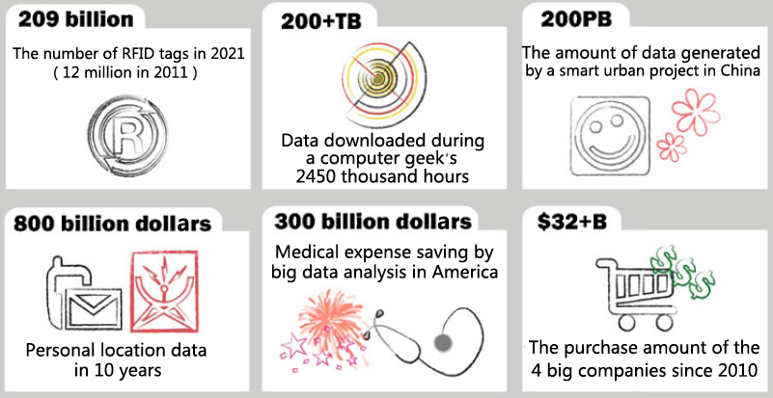
Characteristics of Big Data
WQD7007 Big Data Management
Volume
Large amount of data, big scale of data
Example:
40 Zettabytes of data will be created by 2020, an increase of 300 times from 2015 (size of data units)

Slide 9
Characteristics of Big Data
WQD7007 Big Data Management
Velocity
Analysis of streaming data
Trade data, Internet-of-Things (IoT) sensing, network data
the content of the data is constantly changing, through
the absorption of complementary data collections
previously archived data or legacy collections
from streamed data arriving from multiple sources
Source: https://docs.microsoft.com/en-us/azure/iot-hub/iot-hub-live-data-visualization-in-web-apps

Slide 10
Characteristics of Big Data
WQD7007 Big Data Management
Variety
Different forms of data
Example: traditional databases, text, images, documents, and complex records
Source: https://makeawebsitehub.com/social-media-sites/

Slide 11
Characteristics of Big Data
WQD7007 Big Data Management
Veracity
How to make sure the data is accurate?
Uncertainty of data exist, due to the poor data quality
Example: marketing automation system with false names and inaccurate contact information
One of three business leaders don’t trust the information they use to make decisions

Slide 12
Characteristics of Big Data
WQD7007 Big Data Management
Variability
data whose meaning is constantly changing.
Example: language processing.
Visualization
presenting data using graphs and charts
Value
Get business insights
Know your customer
Source: http://dataconomy.com/2014/05/seven-vs-big-data/, https://www.impactradius.com/blog/7-vs-big-data/

Slide 13
Difference between big data and massive data
WQD7007 Big Data Management
Big Data
Most of the V’s should apply
Massive data
enormous collections of simple-format records
Big data resources are not equivalent to a large spreadsheet, and a big data resource is not analyzed in its totality.
Big Data analysis is a multistep process whereby data is extracted, filtered, and transformed, with analysis often proceeding in a piecemeal, sometimes recursive, fashion.
Notes:
Massive data -> also called ‘lotsa’ data or very big data

Slide 14
Big data and small data
WQD7007 Big Data Management
Big data is NOT
small data that has become bloated to the point that it can no longer fit on a spreadsheet, or
a database that happens to be very large
False impression from professionals who customarily work with relatively small data:
they can apply their spreadsheet and database skills directly to big data resources without mastering new skills and without adjusting to new analytic paradigms
Only the computer need to be improved

Slide 15
Big data and Small data - Difference
WQD7007 Big Data Management
1. Goal:
small data—Usually designed to answer a specific question or serve a particular goal.
Big Data—Usually designed with a goal in mind, but the goal is flexible and the questions posed are protean.
Notes:
Protean – change frequently or easily

Slide 16
Big data and Small data - Difference
WQD7007 Big Data Management
1. Goal:
Example: “to combine high-quality data from fisheries, Coast Guard, commercial shipping, and coastal management agencies for a growing data collection that can be used to support a variety of governmental and commercial management studies in the lower peninsula.”
a vague goal
there really is no way to completely specify
what the big data resource will contain
how the various types of data held in the resource will be organized, connected to other data resources, usefully analyzed.
Nobody can specify, with any degree of confidence, the ultimate destiny of any big data project. It usually comes as a surprise.

Slide 17
Big data and Small data - Difference
WQD7007 Big Data Management
2. Location:
small data—Typically, small data is contained within one institution, often on one computer, sometimes in one file.
Big Data—Typically spread throughout electronic space, typically parceled onto multiple Internet servers, located anywhere on earth.

Slide 18
Big data and Small data - Difference
WQD7007 Big Data Management
3. Data structure and content:
small data—Ordinarily contains highly structured data.
The data domain is restricted to a single discipline or subdiscipline. The data often comes in the form of uniform records in an ordered spreadsheet.
Big Data —Must be capable of absorbing unstructured data (e.g., such as free-text documents, images, motion pictures, sound recordings, physical objects).
The subject matter of the resource may cross multiple disciplines, and the individual data objects in the resource may link to data contained in other big data resources.

Slide 19
Big data and Small data - Difference
WQD7007 Big Data Management
4. Data preparation
small data —In many cases, the data user prepares her own data, for her own purposes.
Big Data —The data comes from many diverse sources, and it is prepared by many people. People who use the data are seldom the people who have prepared the data.

Slide 20
Big data and Small data - Difference
WQD7007 Big Data Management
5. Longevity
small data —When the data project ends, the data is kept for a limited time (seldom longer than 7 years, the traditional academic life span for research data) and then discarded.
Big Data —Big Data projects typically contain data that must be stored in perpetuity.
Ideally, data stored in a Big Data resource will be absorbed into another resource when the original resource terminates. Many Big Data projects extend into the future and the past (e.g., legacy data), accruing data prospectively and retrospectively.
Notes:
perpetuity - the state or quality of lasting forever.

Slide 21
Big data and Small data - Difference
WQD7007 Big Data Management
6. Measurements
small data —Typically, the data is measured using one experimental protocol, and the data can be represented using one set of standard units
Big Data —Many different types of data are delivered in many different electronic formats.
Measurements, when present, may be obtained by many different protocols. Verifying the quality of big data is one of the most difficult tasks for data managers.

Slide 22
Big data and Small data - Difference
WQD7007 Big Data Management
7. Reproducibility
small data —Projects are typically repeatable.
If there is some question about the quality of the data, reproducibility of the data, or validity of the conclusions drawn from the data, the entire project can be repeated, yielding a new data set.
Big Data —Replication of a Big Data project is seldom feasible.
In most instances, all that anyone can hope for is that bad data in a big data resource will be found and flagged as such.

Slide 23
Big data and Small data - Difference
WQD7007 Big Data Management
8. Stakes/cost
small data —Project costs are limited.
Laboratories and institutions can usually recover from the occasional small data failure.
Big Data —Big Data projects can be obscenely expensive.

Slide 24
Big data and Small data - Difference
WQD7007 Big Data Management
9. Introspection/observation
small data —Individual data points are identified by their row and column location within a spreadsheet or database table.
If you know the row and column headers, you can find and specify all of the data points contained within.
Big Data —Unless the Big Data resource is exceptionally well designed, the contents and organization of the resource can be inscrutable, even to the data managers

Slide 25
Big data and Small data - Difference
WQD7007 Big Data Management
10. Analysis
small data —In most instances, all of the data contained in the data project can be analyzed together, and all at once.
Big Data —With few exceptions, such as those conducted on supercomputers or in parallel on multiple computers, Big Data is ordinarily analyzed in incremental steps.
The data are extracted, reviewed, reduced, normalized, transformed, visualized, interpreted, and reanalyzed with different methods.

Slide 26
Six phases of Big Data
WQD7007 Big Data Management
Data generation
Data acquisition
Data storage
Data analysis
Data Visualization or interpretation
Decision making

Slide 27
Data Generation
Four phases of Big Data
WQD7007 Big Data Management
Enterprise Data
online trading data and online analysis data, most of which are historically static data
Internal data e.g. production data, inventory data, sales data, and financial data which aims to capture informationized and data-driven activities in enterprises, so as to record all activities of enterprises
IoT (Internet-of-Things) data
smart cities, industry, agriculture, traffic, transportation, medical care, public departments, and families
Bio-medical data
Medical images and electronic medical records

Slide 28
Data Acquisition
Four phases of Big Data
WQD7007 Big Data Management
Data collection
Log files, sensing, network data
Data transmission/transportation
Inter-DCN transmissions: Inter-DCN transmissions are from data source to data center, which is generally achieved with the existing physical network infrastructure.
Intra-DCN Transmissions: Intra-DCN transmissions are the data communication flows within data centers.
Data pre-processing
Integration, cleaning and redundancy elimination
(DCN – Dynamic circuit network)

Slide 29
Data Storage
Four phases of Big Data
WQD7007 Big Data Management
Storage system for massive data
Direct Attached Storage (DAS)
Network Attached Storage (NAS)
Storage Area Network (SAN)
Distributed storage system
Storage mechanism:
Traditional relational databases
cannot meet the challenges on categories and scales brought about by big data.
NoSQL databases (i.e., non traditional relational databases) feature flexible modes, support for simple and easy copy, simple API, eventual consistency, and support of large volume data.
Example: Key-value databases, column-oriented databases, and document-oriented databases, each based on certain data models.

Slide 30
Data Analysis
Four phases of Big Data
WQD7007 Big Data Management
Traditional data analysis
Cluster Analysis
Factor Analysis
Correlation Analysis
Regression Analysis
A/B testing
Statistical analysis
Data mining algorithms
Big data analytics method:
Bloom Filter
Hashing
Index
Triel
Parallel Computing

Slide 31
Data Visualization and Interpretation
Four phases of Big Data
WQD7007 Big Data Management
To represent knowledge more intuitively and effectively by using different graphs
e.g. Tableau
Decision Making
Decision is made based on the analytical results
Is Big Data really helpful in improving decision making process?

Slide 32
When Big Data is needed?
WQD7007 Big Data Management
Case 1:
An entity has collected a lot of data, in the course of its normal activities, and seeks to organize the data so that materials can be retrieved, as needed.
The Big Data effort is intended to streamline the regular activities of the entity. In this case, the data is just waiting to be used. The entity is not looking to discover anything or to do anything new.
Example: Medical center as an “accidental” Big Data resource. The administrative staff anticipated that the collected data can be used to achieve mandated goals: e.g. improving quality of service, increasing staff efficiency, and reducing operational costs.
Notes:
It simply wants to use the data to do what it has always been doing—only better.
The day-to-day activities of caring for patients and recording data into hospital information systems results in terabytes of collected data in forms such as laboratory reports, pharmacy orders, clinical encounters, and billing data. Most of this information is generated for a one-time specific use (e.g., supporting a clinical decision, collecting payment for a procedure).

Slide 33
When Big Data is needed?
WQD7007 Big Data Management
Case 2:
An entity has collected a lot of data in the course of its normal activities and decides that there are many new activities that could be supported by their data.
Example: Consider modern corporations—these entities do not restrict themselves to one manufacturing process or one target audience. They are constantly looking for new opportunities.
Their collected data may enable them to develop new products based on the preferences of their loyal customers, to reach new markets, or to market and distribute items via the Web. These entities will become hybrid Big Data/manufacturing enterprises.

Slide 34
When Big Data is needed?
WQD7007 Big Data Management
Case 3:
An entity plans a business model based on a Big Data resource. Unlike the previous entities, this entity starts with Big Data and adds a physical component secondarily.
Amazon and FedEx may fall into this category, as they began with a plan for providing a data-intense service (e.g., the Amazon Web catalog and the FedEx package-tracking system). The traditional tasks of warehousing, inventory, pickup, and delivery had been available all along, but lacked the novelty and efficiency afforded by Big Data.

Slide 35
When Big Data is needed?
WQD7007 Big Data Management
Case 4:
An entity is part of a group of entities that have large data resources, all of whom understand that it would be to their mutual advantage to federate (centralize) their data resources.
Example: hospital databases that share electronic medical health records
Source: https://corepointhealth.com/health-information-exchange-architecture-types

Slide 36
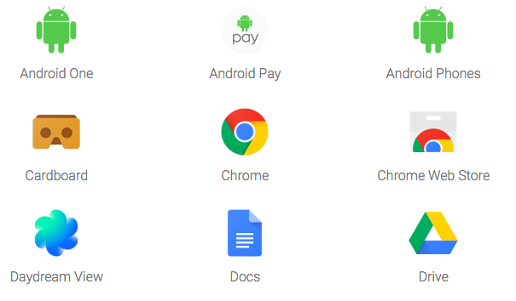
When Big Data is needed?
WQD7007 Big Data Management
Case 5:
An entity with skills and vision develops a project wherein large amounts of data are collected and organized to the benefit of themselves and their user-clients.
Example: Google, and its many services
Source: https://www.google.com/about/products/

Slide 37
When Big Data is needed?
WQD7007 Big Data Management
Case 6:
An entity has no data and has no particular expertise in Big Data technologies, but it has money and vision.
The entity seeks to fund and coordinate a group of data creators and data holders who will build a Big Data resource that can be used by others.
Example: Government agencies have been the major benefactors. These Big Data projects are justified if they lead to important discoveries that could not be attained at a lesser cost, with smaller data resources.

Slide 38
When Big Data is needed?
WQD7007 Big Data Management
The most common purpose of Big Data is to produce SMALL DATA
Imagine using a restaurant locater on your smartphone:
With a few taps, it lists the Italian restaurants located within a 10 block radius of your current location.
The database being queried is big and complex (a map database, a collection of all the restaurants in the world, their longitudes and latitudes, their street addresses, and a set of ratings provided by patrons, updated continuously)
the data that it yields is small (e.g., five restaurants, marked on a street map, with pop-ups indicating their exact address, telephone number, and ratings).
Your task comes down to selecting one restaurant from among the five and dining thereat.

Slide 39
When Big Data is needed?
WQD7007 Big Data Management
The most common purpose of Big Data is to produce SMALL DATA
your data selection was drawn from a large data set, but your ultimate analysis was confined to a small dataset (i.e., five restaurants meeting your search criteria).
The purpose of the Big Data resource was to proffer the small dataset. No analytic work was performed on the Big Data resource—just search and retrieval. The real labor of the Big Data resource involved collecting and organizing complex data so that the resource would be ready for your query. Along the way, the data creators had many decisions to make
e.g., Should bars be counted as restaurants? What about take-away only shops? What data should be collected? How should missing data be handled? How will data be kept current?
Notes:
Proffer – an offer or proposal

Slide 40
Industrial Application
WQD7007 Big Data Management
Big data VS cloud services
Oracle and IBM
Big data VS Internet-of-Things
Smarthome, VYROX
Big data VS data center
Digital realty trust, Equinix
Big data VS Hadoop
Cloudera, Hortonworks
Source: https://www.smarthome.com , http://vyrox.com , http://www.datacenterknowledge.com/archives/2017/01/20/here-are-the-10-largest-data-center-providers-in-the-world
Notes:
Big data VS Artificial Intelligence
Big data VS Industrial 4.0

Slide 41
Key Obstacles of the Big Data applications
WQD7007 Big Data Management
Data representation
many datasets have certain levels of heterogeneity in type, structure, semantics, organization, granularity, and accessibility.
aims to make data more meaningful for computer analysis and user interpretation.
an improper data representation will reduce the value of the original data and may even obstruct effective data analysis.
Efficient data representation shall reflect data structure, class, and type, as well as integrated technologies, so as to enable efficient operations on different datasets.
Notes:
Heterogeneity: quality or state of being diverse in character or content.

Slide 42
Key Obstacles of the Big Data applications
WQD7007 Big Data Management
Redundancy reduction and data compression
Generally, the redundancy level in datasets are high.
Aim to reduce the indirect cost of the entire system on the premise that the potential values of the data are not affected.
Example: most data generated by sensor networks are highly redundant, which may be filtered and compressed at orders of magnitude.

Slide 43
Key Obstacles of the Big Data applications
WQD7007 Big Data Management
Data life cycle management
compared with the relatively slow advances of storage systems, pervasive sensing and computing are generating data at unprecedented rates and scales.
current storage system could not support such massive data.
In general, values hidden in big data depend on data freshness. Therefore, a data importance principle related to the analytical value should be developed to decide which data shall be stored and which data shall be discarded

Slide 44
Key Obstacles of the Big Data applications
WQD7007 Big Data Management
Analytical mechanism
traditional RDBMSs are strictly designed with a lack of scalability and expandability
non-relational databases have shown their unique advantages in the processing of unstructured data. But still exist problems in their performance in particular applications.
a compromising solution between RDBMSs and non-relational databases should be identified.
Example: some enterprises have utilized a mixed database architecture that integrates the advantages of both types of database (e.g., Facebook and Taobao).

Slide 45
Key Obstacles of the Big Data applications
WQD7007 Big Data Management
Data confidentiality
most big data service providers or owners at present could not effectively maintain and analyze such huge datasets because of their limited capacity.
They must rely on professionals or tools to analyze such data, which increase the potential safety risks.
Example: the transactional dataset generally includes a set of complete operating data to drive key business processes.
Such data contains details of the lowest granularity and some sensitive information such as credit card numbers.
Therefore, analysis of big data may be delivered to a third party for processing only when proper preventive measures are taken to protect such sensitive data, to ensure its safety.

Slide 46
Key Obstacles of the Big Data applications
WQD7007 Big Data Management
Energy management
the energy consumption of mainframe computing systems has drawn much attention from both economy and environment perspectives.
With the increase of data volume and analytical demands, the processing, storage, and transmission of big data will inevitably consume more and more electric energy.
Therefore, system-level power consumption control and management mechanism shall be established for big data while the expandability and accessibility are ensured.

Slide 47
Key Obstacles of the Big Data applications
WQD7007 Big Data Management
Expendability and scalability
the analytical system of big data must support present and future datasets.
The analytical algorithm must be able to process increasingly expanding and more complex datasets.
Cooperation
analysis of big data is an interdisciplinary research, which requires experts in different fields cooperate to harvest the potential of big data.
A comprehensive big data network architecture must be established to help scientists and engineers in various fields access different kinds of data and fully utilize their expertise, so as to cooperate to complete the analytical objectives.

Slide 48

Coming Next
WQD7007 Big Data Management
Big data pipeline using Hadoop

Slide 49
References
WQD7007 Big Data Management
[1] M. Chen, S. Mao and Y. Liu, "Big Data: A Survey", Mobile Networks and Applications, vol. 19, no. 2, pp. 171-209, 2014.
[2] C. Philip Chen and C. Zhang, "Data-intensive applications, challenges, techniques and technologies: A survey on Big Data", 2014.
[3] J. Berman, Principles of big data. Amsterdam: Elsevier, 2013.

Slide 50
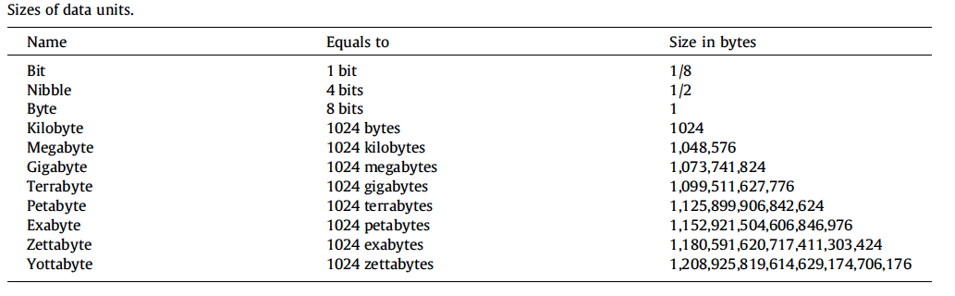
Size of data units
WQD7007 Big Data Management
Back

